Slide 1


Superstore Sales Performance Analysis
This presentation provides a comprehensive analysis of sales performance across various categories, shipping costs, regions, and sub-categories.
by Yash Ghadge

Slide 2
Category-Wise Sales Performance
Technology Dominance
Furniture and Office Supplies
Potential Opportunities
Technology products generate the highest revenue, indicating strong demand and potential for further growth.
Furniture and office supplies also contribute significantly to overall sales, showcasing a steady customer base.
Analyzing specific products within each category can reveal areas for optimizing sales and marketing efforts.

Slide 3
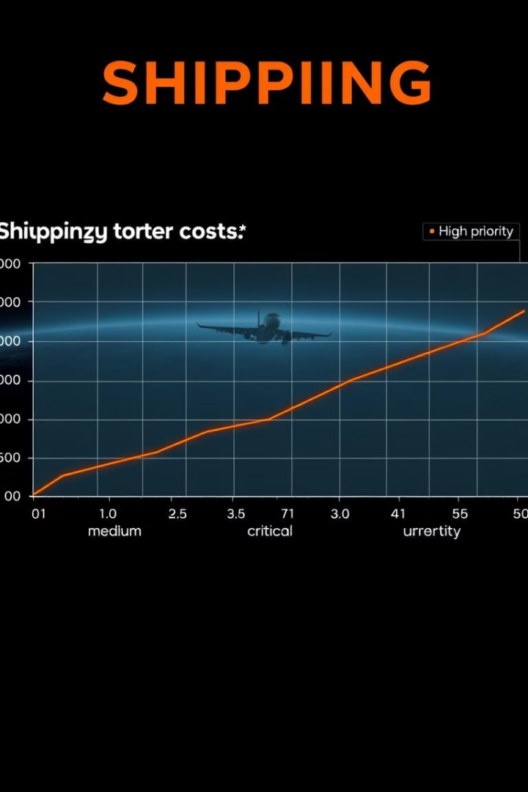



Shipping Cost by Order Priority
High Priority Orders
Higher-priority orders often require expedited shipping, leading to increased costs.
Medium Priority Orders
Medium priority orders have the highest shipping costs, possibly due to a larger average order size.
Lower Priority Orders
Lower priority orders typically involve standard shipping methods, resulting in lower shipping costs.

Slide 4

Overall Metrics
Total Sales
13M
Total Profit
1.47M
Total Quantity Sold
178.31K

Slide 5

Sales by Region
1
Central Region Dominance
2
North Asia and Southeast Asia
The central region accounts for a significant portion of total sales, indicating a strong market presence.
North Asia and Southeast Asia also contribute significantly, suggesting potential for further expansion in these regions.
3
Market Expansion
Exploring new markets and strengthening existing ones in regions with lower sales can drive growth.

Slide 6
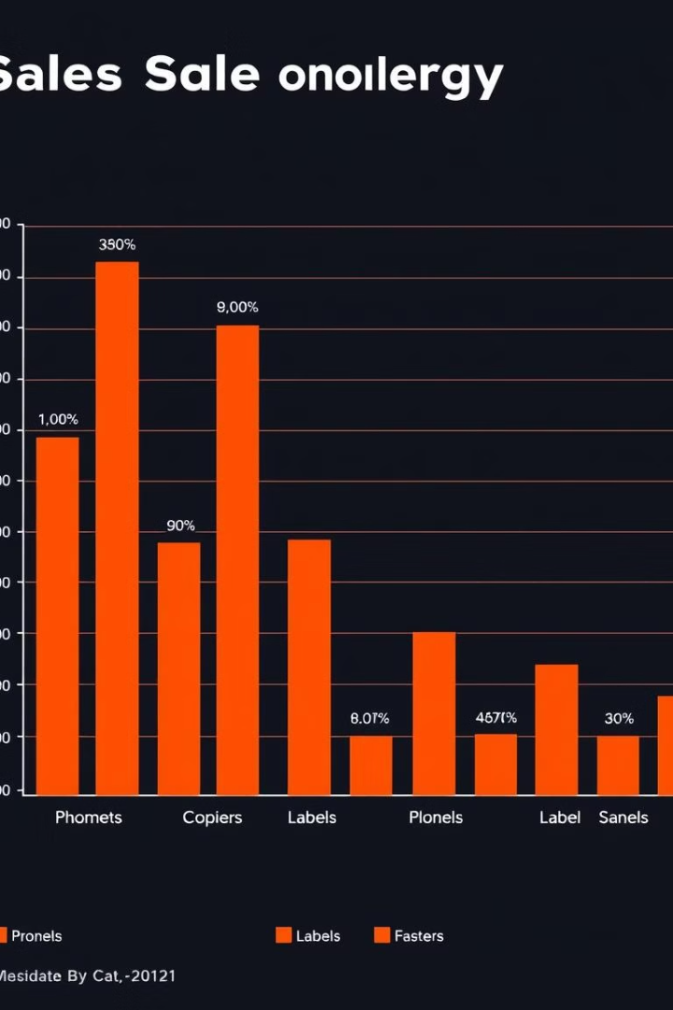
Sales by Sub-Category
High Demand
Low Demand
Phones and copiers are the top-selling sub-categories, suggesting high customer demand and market popularity.
Labels and fasteners have lower sales, indicating potential for improvement through targeted marketing and product optimization.
Product Differentiation
Analyzing the performance of individual products within each sub-category can reveal opportunities for product differentiation and targeted marketing.

Slide 7

Shipping Cost Optimization
1
Negotiate Shipping Rates
Exploring alternative shipping providers and negotiating lower rates can help reduce costs.
2
Optimize Packaging
Efficiently packaging products to minimize shipping volume can lead to lower transportation costs.
3
Consolidate Shipments
Combining multiple orders into a single shipment can reduce individual shipping costs and optimize logistics.

Slide 8




Profitability Enhancement
Cost Reduction
Identifying areas for cost optimization in areas like manufacturing, logistics, and marketing can improve profitability.
Price Optimization
Strategically adjusting prices to maximize revenue and maintain customer satisfaction can boost profitability.
Effective Marketing
Targeted marketing campaigns to reach the right customer segments can increase sales and boost profitability.

